Slide 1
DIGITAL LOGIC & COMPUTER ORGANISATION(BCA183)
DR. ACHALA SHAKYA
ASSISTANT PROFESSOR
SOCS

Slide 2
A. LOGIC GATES
Logic gates are the basic building blocks of any digital system.
It is an electronic circuit having one or more than one input and only one output.
The relationship between the input and the output is based on a certain logic.
In a circuit, logic gates will make decisions based on a combination of digital signals coming from its inputs.
Most logic gates have two inputs and one output.
Logic gates are based on Boolean algebra.
We can classify these Logic gates into the following three categories.
Basic Gates
Universal Gates
Special Gates

Slide 3
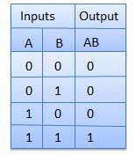

BASIC LOGIC GATES
AND GATE
The AND gate is so named because, if 0 is called "false" and 1 is called "true," the gate acts in the same way as the logical "and" operator. The following illustration and table show the circuit symbol and logic combinations for an AND gate. (In the symbol, the input terminals are at left and the output terminal is at right.) The output is "true" when both inputs are "true." Otherwise, the output is "false." In other words, the output is 1 only when both inputs one AND two are 1. This logical AND is represented with the symbol ‘.’
Logic diagram
Truth Table

Slide 4
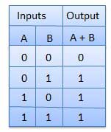

2. OR GATE
The OR gate gets its name from the fact that it behaves after the fashion of the logical inclusive "or." The output is "true" if either or both of the inputs are "true." If both inputs are "false," then the output is "false." In other words, for the output to be 1, at least input one OR two must be 1. This logical OR is represented with the symbol ‘+’.
Logic diagram
Truth Table

Slide 5
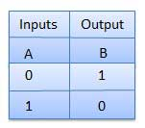

3. NOT GATE
A logical inverter, sometimes called a NOT gate to differentiate it from other types of electronic inverter devices, has only one input. It reverses the logic state. If the input is 1, then the output is 0. If the input is 0, then the output is 1.
Logic diagram
Truth Table

Slide 6
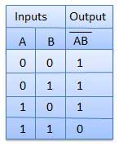

UNIVERSAL GATES
NAND & NOR gates are called as universal gates. Because we can implement any Boolean function, which is in sum of products form by using NAND gates alone. Similarly, we can implement any Boolean function, which is in product of sums form by using NOR gates alone.
1.NAND GATE
NAND gate is a digital circuit that has two or more inputs and produces an output, which is the inversion of logical AND of all those inputs.
Truth Table
Logic diagram

Slide 7
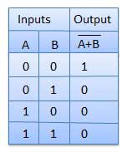

2. NOR GATE
NOR gate is a digital circuit that has two or more inputs and produces an output, which is the inversion of logical OR of all those inputs.
Truth Table
Logic diagram
Here A, B are the inputs and Y is the output. If both inputs are ‘0’, then the output, Y is ‘1’. If at least one of the input is ‘1’, then the output, Y is ‘0’. This is just opposite to that of two input OR gate operation.

Slide 8
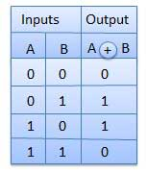

SPECIAL GATES
Ex-OR & Ex-NOR gates are called as special gates. Because, these two gates are special cases of OR & NOR gates.
1. EX-OR GATE
The full form of Ex-OR gate is Exclusive-OR gate. The output is "true" if either, but not both, of the inputs are "true." The output is "false" if both inputs are "false" or if both inputs are "true." Another way of looking at this circuit is to observe that the output is 1 if the inputs are different, but 0 if the inputs are the same.
Truth Table
Logic diagram

Slide 9
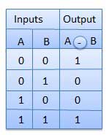

2. XNOR Gate
The XNOR (exclusive-NOR) gate is a combination XOR gate followed by an inverter. Its output is "true" if the inputs are the same, and "false" if the inputs are different.
Truth Table
Logic diagram

Slide 10
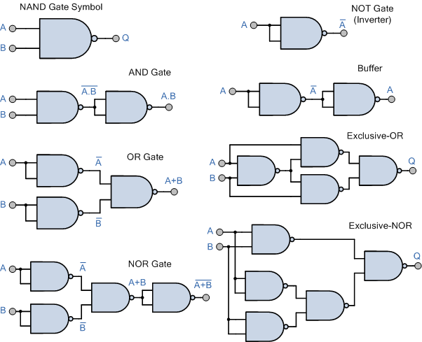
LOGIC GATES IMPLEMENTATION USING NAND GATE

Slide 11
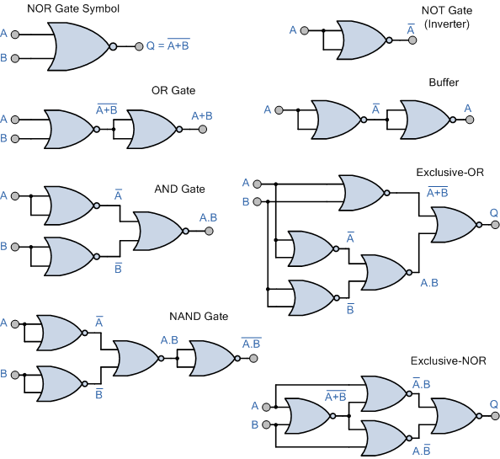
LOGIC GATES IMPLEMENTATION USING NOR GATE

Slide 12
B. BOOLEAN ALGERA
Boolean Algebra is used to analyze and simplify the digital (logic) circuits. It uses only the binary numbers i.e. 0 and 1.
It is also called as Binary Algebra or logical Algebra.
Boolean algebra was invented by George Boole in 1854.

Slide 13
RULE IN BOOLEAN ALGEBRA
Following are the important rules used in Boolean algebra.
Variable used can have only two values. Binary 1 for HIGH and Binary 0 for LOW.
Complement of a variable is represented by an overbar (-). Thus, complement of variable B is represented as B Bar. Thus if B = 0 then B Bar = 1 and B = 1 then B Bar = 0.
ORing of the variables is represented by a plus (+) sign between them. For example ORing of A, B, C is represented as A + B + C.
Logical ANDing of the two or more variable is represented by writing a dot between them such as A.B.C. Sometime the dot may be omitted like ABC.

Slide 14
BOOLEAN LAWS
There are six types of Boolean Laws.
1. Commutative law
Any binary operation which satisfies the following expression is referred to as commutative operation.
Commutative law states that changing the sequence of the variables does not have any effect on the output of a logic circuit.

Slide 15
2.Associative law
This law states that the order in which the logic operations are performed is irrelevant as their effect is the same.
3. Distributive law
Distributive law states the following condition.

Slide 16


4. AND law
These laws use the AND operation. Therefore they are called as AND laws.
5. OR law
These laws use the OR operation. Therefore they are called as OR laws.

Slide 17
6. INVERSION LAW
This law uses the NOT operation. The inversion law states that double inversion of a variable results in the original variable itself.
7. De Morgan law
The operation of an AND or OR logic circuit is unchanged if all inputs are inverted, the operator is changed from AND to OR, the output is inverted,
(A.B)’=A’+B’ (A+B)’ = A’.B’

Slide 18
SIMPLIFICATION USING ALGEBRAIC FUNCTIONS
Example 1: (A + B)(A + C)
(A + B)(A + C) = AA + AC + AB + BC Distributive law
= A + AC + AB + BC AA = A
= A( 1 + C) + AB + BC 1 + C = 1
= A. 1 + AB + BC Factoring (distributive law)
= A(1 + B) + BC 1 + B = 1
= A. 1 + BC A . 1 = A
= A + BC

Slide 19
EXAMPLE 2: C + (BC)’
=C + (BC)’ Original Expression
=C + (B’ + C’) De Morgan's Law.
=(C + C’) + B’ Commutative, Associative Laws.
=1 + B’ Complement Law.
=1 Identity Law.

Slide 20
Let us consider an example of a Boolean function: AB+A (B+C) + B (B+C)
AB + AB + AC + BB + BC {Distributive law; A (B+C) = AB+AC, B (B+C) = BB+BC}
AB + AB + AC + B + BC {Idempotent law; BB = B}
AB + AC + B + BC {Idempotent law; AB+AB = AB}
AB + AC +B {Absorption law; B+BC = B}
B + AC {Absorption law; AB+B = B}
Hence, the simplified Boolean function will be B + AC.

Slide 21
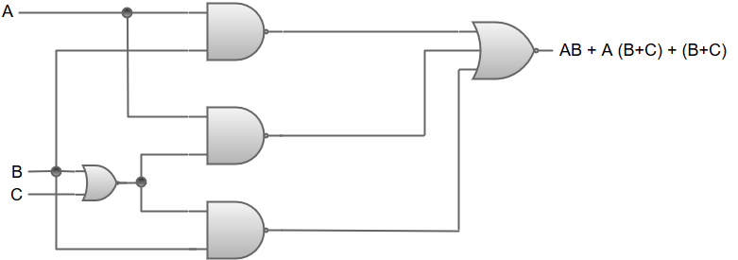
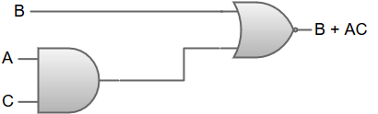
The logic diagram for the Boolean function AB+A (B+C) + B (B+C) can be represented as:
The logic diagram for Boolean function B + AC can be represented as:

Slide 22
Minimize the following Boolean expression using Algebric Simplification
F(A,B,C)=A′B+BC′+BC+AB′C′
A′B+(BC′+BC′)+BC+AB′C′ [indeponent law]
= A′B+(BC′+BC)+(BC’+AB′C′)
= A′B+B(C′+C)+C’(B+AB′)
=A’B + B.1+ c’ (B+A)
= B(A′+1)+C′(B+A)
=B + C′(B+A) [A’+1=1]
= B+BC′+AC′
= B(1+C′)+AC′
= B+AC′ [1+C’ = 1]

Slide 23
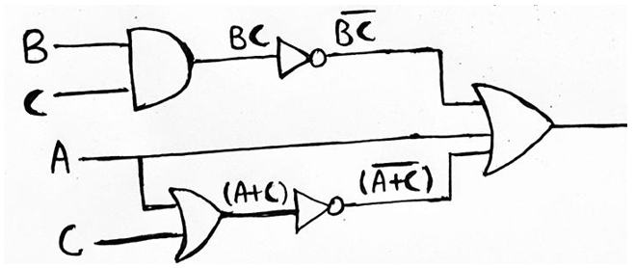
REALIZATION OF BOOLEAN EXPRESSION USING GATES
Example1: Realize the Boolean Expression (BC)’ + A + (A + C)’ using AOI logic.

Slide 24
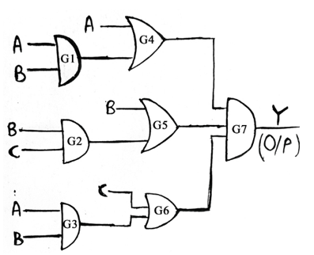
EXAAMPLE 2: Find out the Boolean Expression for Logic Diagram given below and simplify the output in the minimal expression, also implement the simplified expression using the AOI logic

Slide 25
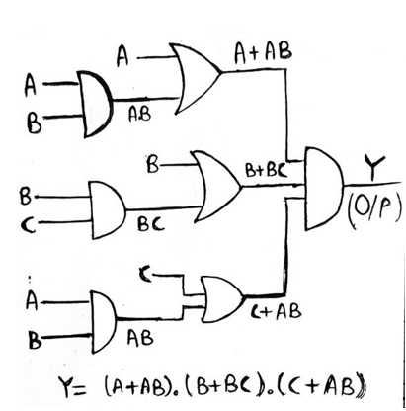
Solution:
Following the forward propagation approach, we see that gate G1 is a 2-input AND Gate having inputs A and B. So, output of G1 will be AB. Similarly, G2 is an OR Gate, so output of G2 will be (B+C). Also, G3 is an AND Gate and its output will be AB.
Now, gate G4 is a 2-input OR Gate which has one of its inputs as A and the other one is the output of gate G1, thus the output of gate G4 will be (A + AB). Similarly, output for gate G5 and G6 will be (B + BC) and (C + AB) respectively. Now, gate G7 is a 3-input AND Gate, therefore output (Y) of G7 will be equal to (A+AB). (B+BC). (C+AB)

Slide 26
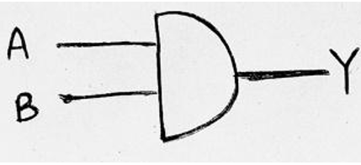
Since, we have Y = (A+AB). (B+BC). (C+AB), now we have to minimize it.
Therefore, (A+AB). (B+BC). (C+AB)
= A (1 + B). B (1 +C). (C+AB)
= A. B. (C+AB) [Since, 1+B =1 and 1+C =1]
= AB (1 + C)
= AB
Therefore, Y=AB is the minimal expression. This can be implemented using a 2-input AND Gate having inputs A and B as:

Slide 27
SOP AND POS
Representation of Boolean expression can be primarily done in two ways. They are as follows:
Sum of Products (SOP) form
Product of Sums (POS) form
NOTE: If the number of input variables are n, then the total number of combinations in Boolean algebra is 2^{n}.

Slide 28
SUM OF PRODUCTS (SOP)
It is one of the ways of writing a boolean expression. As the name suggests, it is formed by adding (OR operation) the product terms. These product terms are also called as ‘min-terms’. Min-terms are represented with ‘m’, they are the product(AND operation) of boolean variables either in normal form or complemented form.
A B C X
0 0 0 0
0 0 1 1
0 1 0 0
0 1 1 1
1 0 0 0
1 0 1 0
1 1 0 1
1 1 1 0
The function X can be written in SOP form by adding all the min-terms when X is HIGH(1).
While writing SOP, the following convention is to be followed:
If variable, A is Low(0) - A'
A is High(1) - A
X (SOP) = ∑ m(1, 3, 6)
= A’.B’.C + A’.B.C + A.B.C’

Slide 29
PRODUCT OF SUMS (POS)
As the name suggests, it is formed by multiplying(AND operation) the sum terms. These sum terms are also called as ‘max-terms’. Max-terms are represented with ‘M’, they are the sum (OR operation) of Boolean variables either in normal form or complemented form.
A B C X
0 0 0 0
0 0 1 1
0 1 0 0
0 1 1 1
1 0 0 0
1 0 1 0
1 1 0 1
1 1 1 0
The function X can be written in POS form by multiplying all the max-terms when X is LOW(0).
While writing POS, the following convention is to be followed:
If variable, A is Low(0) - A
A is High(1) - A'
X (POS) = ∏M(0, 2, 4, 5, 7)
= (A+B+C).(A+B'+C).(A'+B+C).(A'+B+C').(A'+B'+C')

Slide 30
DIFFERENCE BETWEEN SOP AND POS
S.No. | SOP | POS
1. | A way of representing boolean expressions as sum of product terms. | A way of representing boolean expressions as product of sum terms.
2. | SOP uses minterms. Minterm is product of boolean variables either in normal form or complemented form. | POS uses maxterms. Maxterm is sum of boolean variables either in normal form or complemented form.
3. | It is sum of minterms. Minterms are represented as ‘m’ | It is product of maxterms. Maxterms are represented as ‘M’
4. | SOP is formed by considering all the minterms, whose output is HIGH(1) | POS is formed by considering all the maxterms, whose output is LOW(0)
5. | While writing minterms for SOP, input with value 1 is considered as the variable itself and input with value 0 is considered as complement of the input. | While writing maxterms for POS, input with value 1 is considered as the complement and input with value 0 is considered as the variable itself.

Slide 31
C. K-MAPS
Karnaugh map method or K-map method is a graphical method, which consists of 2^{n} cells for ‘n’ variables.
K-Map method is most suitable for minimizing Boolean functions of 2 variables to 5 variables.
The K-map is a systematic way of simplifying Boolean expressions. With the help of the K-map method, we can find the simplest POS and SOP expression, which is known as the minimum expression.

Slide 32
STEPS TO SOLVE EXPRESSION USING K-MAP-
Select K-map according to the number of variables.
Identify minterms or maxterms as given in problem.
For SOP put 1’s in blocks of K-map respective to the minterms (0’s elsewhere).
For POS put 0’s in blocks of K-map respective to the maxterms(1’s elsewhere).
Make rectangular groups containing total terms in power of two like 2,4,8 ..(except 1) and try to cover as many elements as you can in one group.
From the groups made in step 5 find the product terms and sum them up for SOP form.

Slide 33
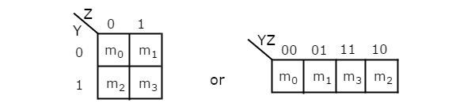
2 Variable K-Map
The number of cells in 2 variable K-map is four, since the number of variables is two. The following figure shows 2 variable K-Map.
There is only one possibility of grouping 4 adjacent min terms.
The possible combinations of grouping 2 adjacent min terms are {(m₀, m₁), (m₂, m₃), (m₀, m₂) and (m₁, m₃)}.

Slide 34

3 Variable K-Map
The number of cells in 3 variable K-map is eight, since the number of variables is three. The following figure shows 3 variable K-Map.

Slide 35
There is only one possibility of grouping 8 adjacent min terms.
The possible combinations of grouping 4 adjacent min terms are {(m₀, m₁, m₃, m₂), (m₄, m₅, m₇, m₆), (m₀, m₁, m₄, m₅), (m₁, m₃, m₅, m₇), (m₃, m₂, m₇, m₆) and (m₂, m₀, m₆, m₄)}.
The possible combinations of grouping 2 adjacent min terms are {(m₀, m₁), (m₁, m₃), (m₃, m₂), (m₂, m₀), (m₄, m₅), (m₅, m₇), (m₇, m₆), (m₆, m₄), (m₀, m₄), (m₁, m₅), (m₃, m₇) and (m₂, m₆)}.
If x=0, then 3 variable K-map becomes 2 variable K-map.

Slide 36
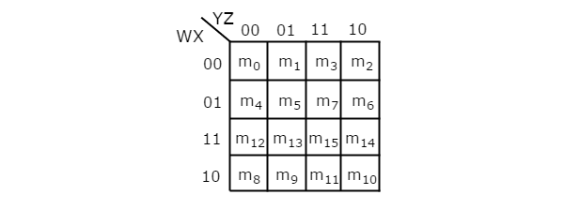
4 Variable K-Map
The number of cells in 4 variable K-map is sixteen, since the number of variables is four. The following figure shows 4 variable K-Map

Slide 37
There is only one possibility of grouping 16 adjacent min terms.
Let R₁, R₂, R₃ and R₄ represents the min terms of first row, second row, third row and fourth row respectively. Similarly, C₁, C₂, C₃ and C₄ represents the min terms of first column, second column, third column and fourth column respectively. The possible combinations of grouping 8 adjacent min terms are {(R₁, R₂), (R₂, R₃), (R₃, R₄), (R₄, R₁), (C₁, C₂), (C₂, C₃), (C₃, C₄), (C₄, C₁)}.
If w=0, then 4 variable K-map becomes 3 variable K-map.

Slide 38
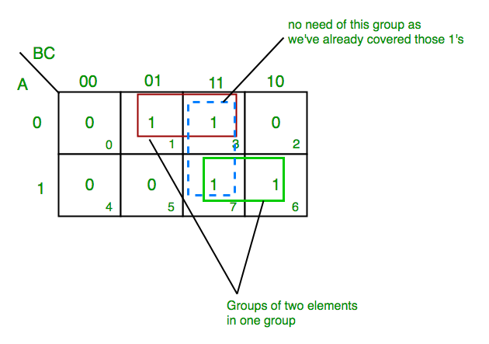
K-map of 3 variables using SOP form-
Z= ∑A,B,C(1,3,6,7)
From red group we get product term—
A’C
From green group we get product term—
AB
Summing these product terms we get- Final expression (A’C+AB)

Slide 39
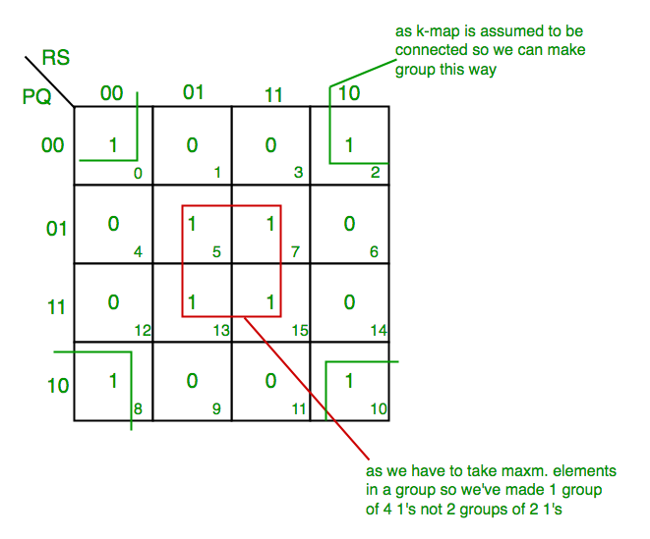
Example 2: K-map for 4 variables Using SOP Form
F(P,Q,R,S)=∑(0,2,5,7,8,10,13,15)
From red group we get product term—
QS
From green group we get product term—
Q’S’
Summing these product terms we get- Final expression (QS+Q’S’)

Slide 40
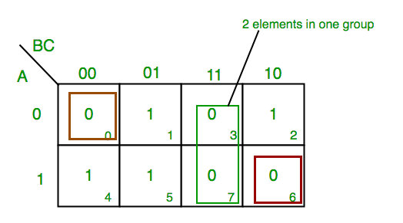
EXAMPLE 1: K-map of 3 variables Using POS Form-
F(A,B,C)=π(0,3,6,7)
From red group we find terms
A B C’
Taking complement of these two
A’ B’ C
Now sum up them
(A’ + B’ + C)
From green group we find terms
B C
Taking complement of these two terms
B’ C’
Now sum up them
(B’+C’)
We will take product of these three terms :Final expression (A' + B’) (B’ + C’) (A + B + C)

Slide 41
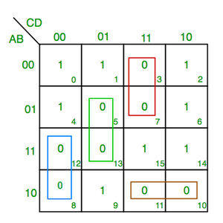
EXAMPLE 2: K-map of 4 variables Using POS Form-
F(A,B,C,D)=π(3,5,7,8,10,11,12,13)
From green group we find terms
C’ D B
Taking their complement and summing them
(C+D’+B’)
From red group we find terms
C D A’
Taking their complement and summing them
(C’+D’+A)
From blue group we find terms
A C’ D’
Taking their complement and summing them
(A’+C+D)
From brown group we find terms
A B’ C
Taking their complement and summing them
(A’+B+C’)
Finally we express these as product –(C+D’+B’).(C’+D’+A).(A’+C+D).(A’+B+C’)

Slide 42
PRACTICE QUESTION
Q1. Minimize the following boolean function-
F(A, B, C, D) = Σm(0, 1, 2, 5, 7, 8, 9, 10, 13, 15)
Q2. Minimize the following boolean function-
F(A, B, C, D) = Σm(0, 1, 3, 5, 7, 8, 9, 11, 13, 15)

Slide 43
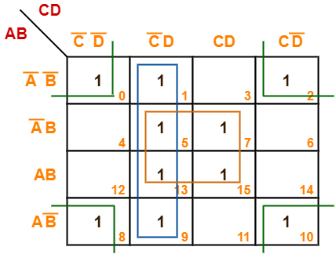
Solution 1-
Thus, minimized Boolean Expression is-
F(A, B, C, D) = BD + C’D + B’D’

Slide 44
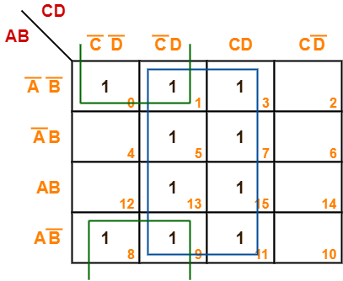
Solution 2-
Thus, minimized boolean expression is-
F(A, B, C, D) = B’C’ + D

Slide 45
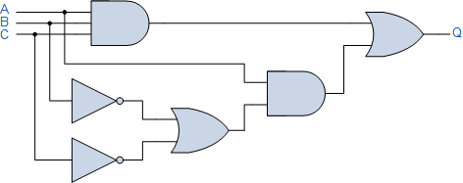
ASSIGNMENT -1
Q1. Define Logic Gates. Explain why NOR and NAND gates are called Universal Gates?
Q2. Elaborate all the BOOLEAN LAWS .
Q3. Illustrate how NOR gate is used to implement an AND , NOT and OR Gate.
Q4. Simplify: A(A + B) + (B + AA)(A + B) using Boolean Algebra.
Q5. Simplify F(A,B,C,D)=Σπ(3,5,7,8,10,11,12,13) using POS form
Q6. Minimize the following boolean function-
F(A, B, C, D) = Σm(0, 1, 2, 5, 7, 8, 9, 10, 13, 15)
Q7. Find the Boolean algebra expression for the following system.
Q8. Draw a logic circuit for (A + B)(C + D)C and simplify the expression .

Slide 46
Q9. Write an SOP expression for this truth table, and then draw a gate circuit diagram corresponding to that SOP expression.
A B C Output
0 0 0 0
0 0 1 0
0 1 0 1
0 1 1 1
1 0 0 0
1 0 1 0
1 1 0 0
1 1 1 1
Finally, simplify this expression using Boolean algebra, and draw a simplified gate circuit based on this new (reduced) Boolean expression.

Slide 47
Q.10 Write a Boolean expression for this truth table in POS form, then simplify that expression as much as possible, and draw a logic gate circuit equivalent to that simplified expression:
A B C Output
0 0 0 1
0 0 1 1
0 1 0 1
0 1 1 1
1 0 0 1
1 0 1 1
1 1 0 0
1 1 1 0

Slide 48
THANK YOU !!

